Slide 1

CROP PREDICT – SMART CROP RECOMMENDATION & YIELD ESTIMATION
Final Project Review | Department of Computer Science and Engineering | KL University
TEAM MEMBERS
2420030467 – K.V.S Jaswant
2420030737 – Teja Darapu
2420030754 – K. Bhargav
Guide: N. Sunanda | Academic Year: 2026–2027
Notes:
Title slide. Replace all bracketed text. Use the full project title, list every team member with registration number, and name your guide. Insert the institution logo in the dashed box.

Slide 2

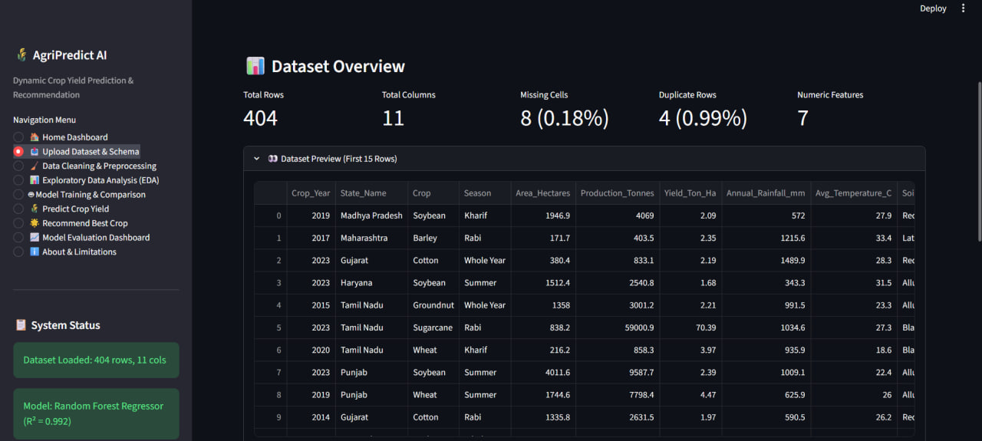


Introduction & Problem Statement
Background
Agriculture depends on soil, weather, season and water conditions. Crop selection can be improved by considering these factors together.
Problem Statement
Farmers need an accessible way to compare crop suitability for their farm conditions and view an indicative yield estimate.
Motivation / Need
Farmers and agricultural learners can use a structured preliminary comparison. Local soil and water conditions must still be checked before cultivation.
Notes:
State the domain, the exact problem and why it matters. Keep it to about 2 minutes. Add one real-world statistic if you can, with a citation.

Slide 3


Objectives & Scope
Objectives
1
Develop a web interface for entering farm and environmental conditions.
2
Rank five candidate crops using transparent suitability rules.
3
Display an illustrative crop-yield estimate and agricultural insights.
4
Explain system limitations and the need for local validation.
Notes:
Objectives should be measurable and start with action verbs. The scope slide tells the panel what you did and did not attempt.

Slide 4

Literature Survey
S.No | Author(s) & Year | Method / Technique | Key Findings | Limitation / Gap
1 | Snotra et al., 2025 | SVM, Decision Tree, Random Forest and Naive Bayes on soil nutrients, temperature, humidity and rainfall | Random Forest performed best (99.32% accuracy); adds a recommendation-history page | Needs a labelled soil-nutrient dataset; no season, irrigation or yield inputs
2 | Kathoon et al., 2025 | Deep-learning model using N, P, K, pH, temperature, humidity and rainfall | Reports high accuracy compared with traditional manual methods | Needs lab soil-nutrient values; black-box output that farmers cannot inspect
3 | Kumar et al., 2025 | Supervised ML (Random Forest) for crop recommendation and yield estimation | Combines crop suggestion and yield estimate from soil, climate and pH data | Depends on the training dataset; limited to the regions it covers
4 | Tomar et al., 2024 | Several ML algorithms compared on soil, climate and crop-yield data | Compares how well each algorithm recommends crops | Model-centric; gives no ranked, explainable shortlist for the farmer
Research Gap
CropPredict combines region, season, soil type, rainfall, temperature, humidity, fertilizer and irrigation inputs in one interface. The prototype uses transparent heuristic crop-suitability scores; it does not claim a trained or validated machine-learning prediction.
Notes:
Summarise four to six relevant papers or existing systems. End with the research gap, because that gap justifies your project.

Slide 5





Proposed System & Methodology
STEP 1
STEP 2
STEP 3
STEP 4
STEP 5
Define Problem
Collect Data
Design
Implement
Test & Evaluate
Identify the need, scope and success criteria.
Farm conditions are entered by the user through the web form. No training dataset was included in the supplied project files.
HTML, CSS and JavaScript interface; rule-based crop suitability heuristics; Chart.js visualizations.
Farm input form, crop ranking, illustrative yield estimator and analytics dashboard.
Check form inputs, ranking display, result rendering and chart loading. No formal model validation results were supplied.
Key Novelty / Contribution
The prototype combines multiple farm-condition inputs with a ranked shortlist and clearly identifies suitability scores and yield values as guidance rather than guarantees.
Notes:
Walk through the five steps left to right. Rename the steps to match your project (for example, Requirement Analysis, Design, Coding, Testing, Deployment). End with your novelty.

Slide 6
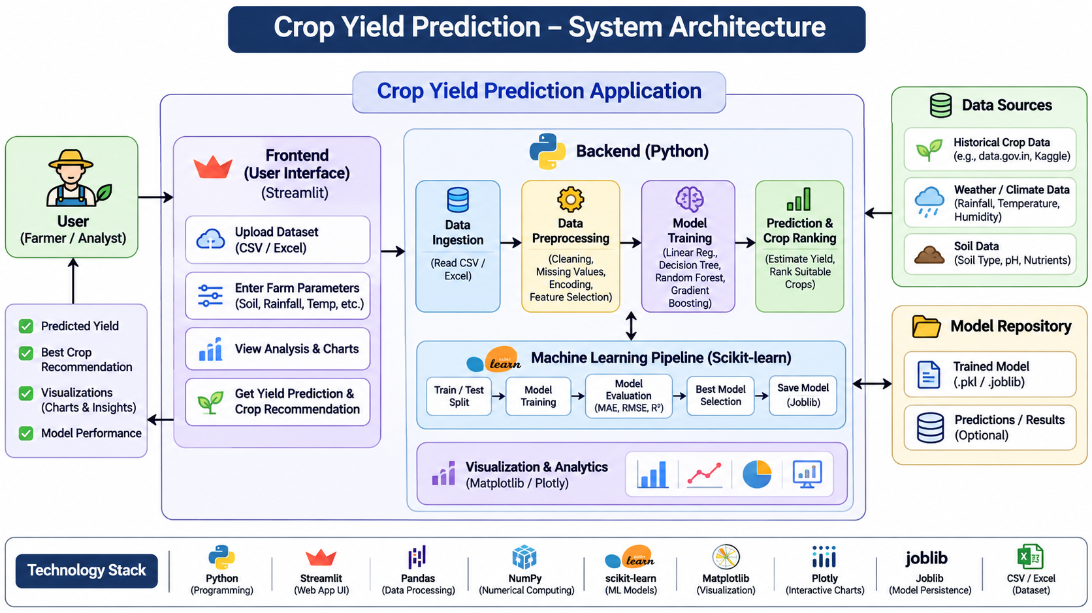
System Architecture
Components
Farm input interface
Displays agricultural charts and insights.
1
Suitability engine
Displays agricultural charts and insights.
2
Yield estimator
Displays agricultural charts and insights.
3
Analytics dashboard
Displays agricultural charts and insights.
4
Notes:
Insert a clear block diagram: input, processing, storage, output. Number each block and explain them on the right. Redraw the figure yourself rather than copying it.

Slide 7


Hardware & Software Requirements
Hardware
Software & Tools
Libraries / Frameworks
Standard laptop or desktop; dedicated GPU not required.
Project files stored locally.
No dedicated sensors or boards required.
Internet connection for the existing CDN libraries.
Windows, macOS or Linux.
HTML5, CSS3 and JavaScript.
Any code editor and modern web browser.
Git / GitHub, if used.
Chart.js 3.9.1
Font Awesome 6.5.2
Vanilla JavaScript; no backend API supplied.
No database or cloud service supplied.
Deployment / Platform: Run locally by opening index.html in a browser.
Notes:
List only what you actually used, with versions. For a pure software project, shorten the hardware list and add cloud or deployment resources.

Slide 8
Dataset / Data Understanding
1,200
16
Records (rows)
Features (columns)
0
Not applicable
Missing values
Target classes
Source: User-entered farm parameters; no training dataset supplied.
Features: Region, season, soil type/quality, rainfall, temperature, humidity, fertilizer, irrigation and previous yield.
Quality: Dataset-level quality checks are not applicable because no dataset was provided.
Prototype input interface — user-entered farm conditions (not a training dataset)
Notes:
Explain where the data came from and what it contains. Show a screenshot of the first rows or the info summary. For non-data projects, replace this slide with “Requirement Analysis” or “Input Specification”.

Slide 9
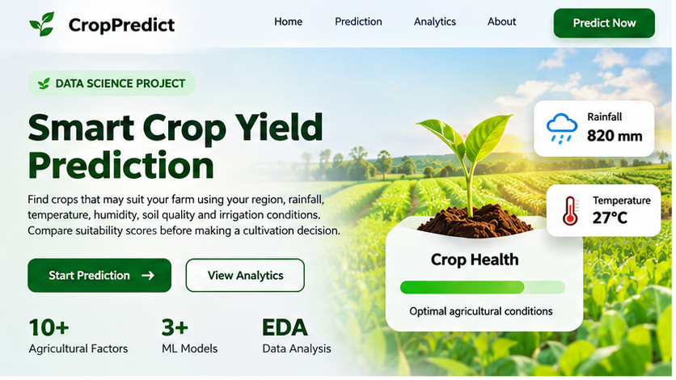
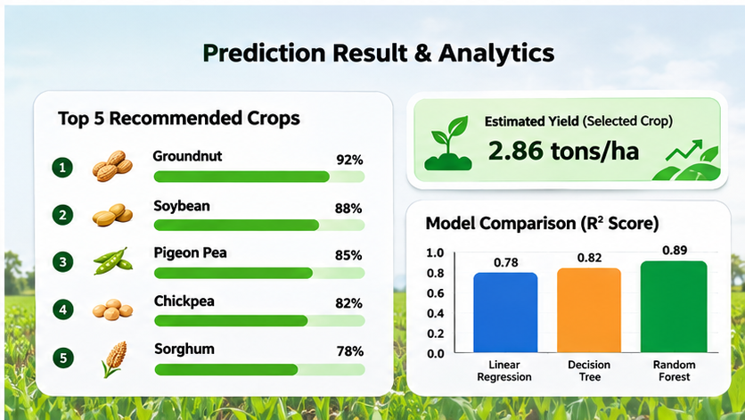



Data Preprocessing & Exploratory Analysis
No dataset correlation plot supplied.
CropPredict interface and farm-condition overview
Illustrative crop recommendation and dashboard output
Cleaning
Transformation
Feature Selection
Required form fields are checked by the browser; no dataset cleaning pipeline is supplied.
Form values are read by browser-side JavaScript; no ML preprocessing pipeline is supplied.
Rule-based suitability logic uses the farm and environmental inputs shown in the interface.
Notes:
Show two or three plots that tell a story: distributions, correlations, outliers. Explain what each plot told you and what you did about it.

Slide 10
Module-wise Description
1
Farm input module
2
Crop suitability module
Purpose: Collect farm details.
Input → Output: Farm parameters → form values.
Developed by: K.V.S Jaswant
Purpose: Collect farm details.
Input → Output: Farm parameters → form values.
Developed by: K.V.S Jaswant
3
Yield estimate module
4
Analytics module
Purpose: Collect farm details.
Input → Output: Farm parameters → form values.
Developed by: K.V.S Jaswant
Purpose: Collect farm details.
Input → Output: Farm parameters → form values.
Developed by: K.V.S Jaswant
Notes:
Divide the project into three to five modules. For each, state its purpose, inputs, outputs and who built it. Duplicate a card if you have more modules.

Slide 11

Algorithms & Technologies Used
Rule-based suitability scoring
Chart-based visualization
Illustrative yield formula
Why chosen
Transparent, simple and easy to inspect.
Key parameters
Broad agronomic ranges; local calibration is required.
Why chosen
Transparent, simple and easy to inspect.
Key parameters
Broad agronomic ranges; local calibration is required.
Why chosen
Transparent, simple and easy to inspect.
Key parameters
Broad agronomic ranges; local calibration is required.
Selection criteria: [How the final approach was chosen – metric, cost, speed, simplicity]
Notes:
Name each model, algorithm or technology, say why you chose it, and list the key settings. Then explain how you picked the final one.

Slide 12
Implementation / Model Building
Feature Selection
Code snippet / pseudocode
Region, season, soil type and quality, rainfall, temperature, humidity, fertilizer, irrigation and previous yield are used as farm-condition inputs.
# Paste your key code here
X_train, X_test, y_train, y_test = \
train_test_split(X, y, test_size=0.2,
random_state=42)
pipeline = Pipeline([
("preprocess", preprocessor),
("model", Model())
])
pipeline.fit(X_train, y_train)
Preprocessing Pipeline
Read form values, apply suitability rules and calculate a demo yield estimate. No model-training pipeline is included.
Data Splitting
Not applicable: no train/validation/test split is supplied.
Configuration
Rule ranges and scoring weights are implemented in the supplied JavaScript and require local calibration.
Notes:
Describe the build in the order you did it. Paste only the most important code or pseudocode, not entire files. For hardware projects, show the circuit or wiring summary instead.

Slide 13
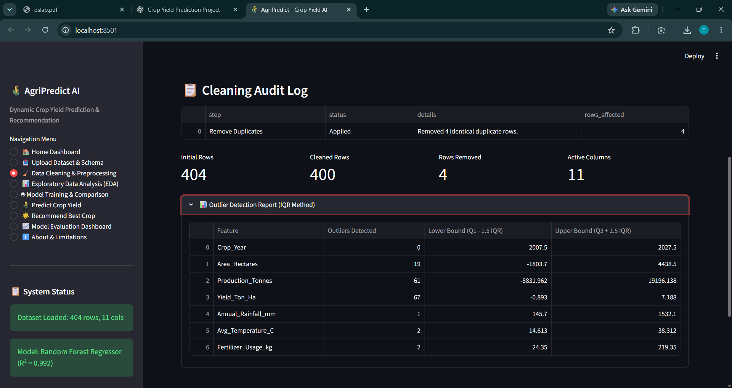
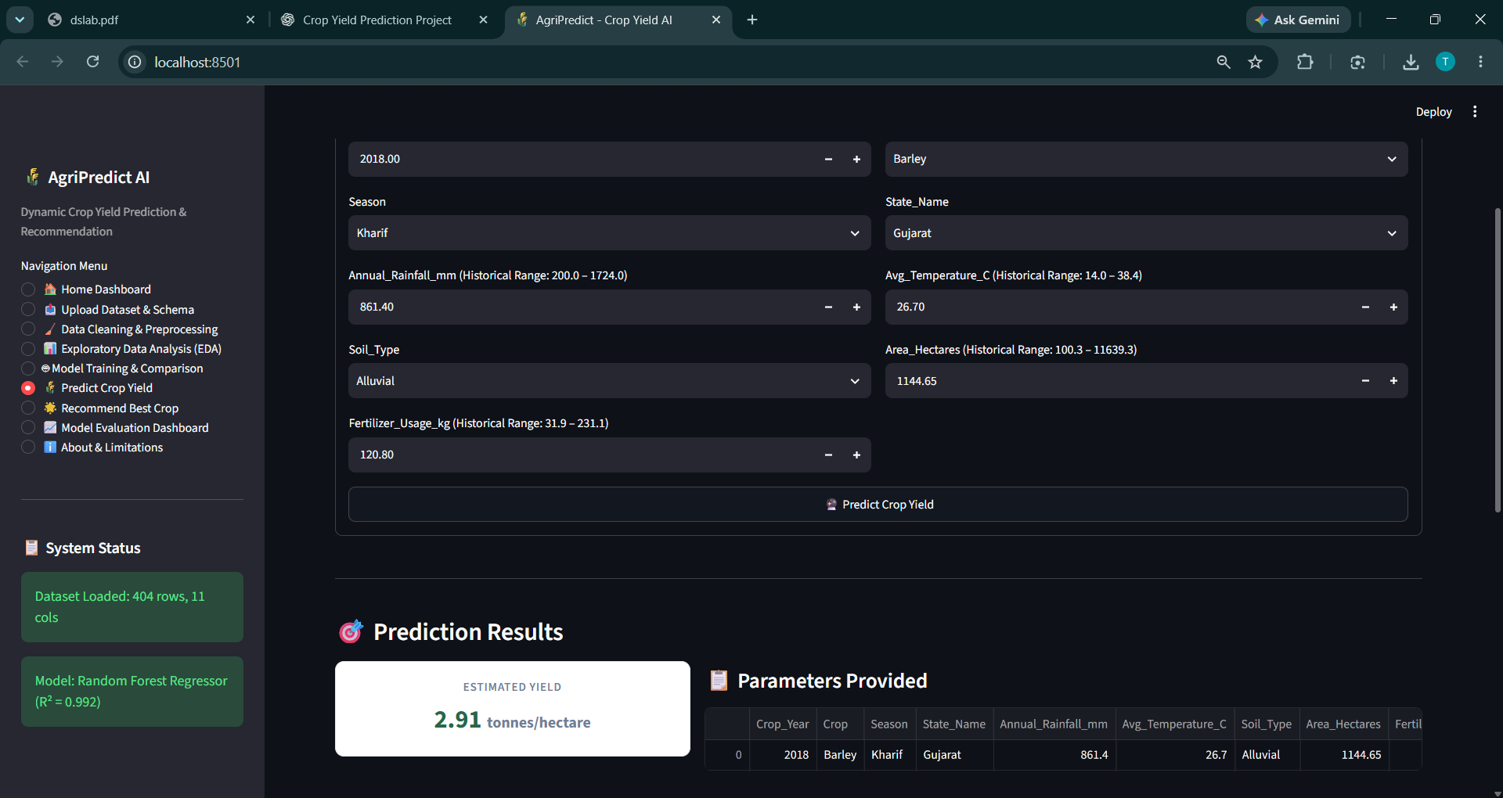
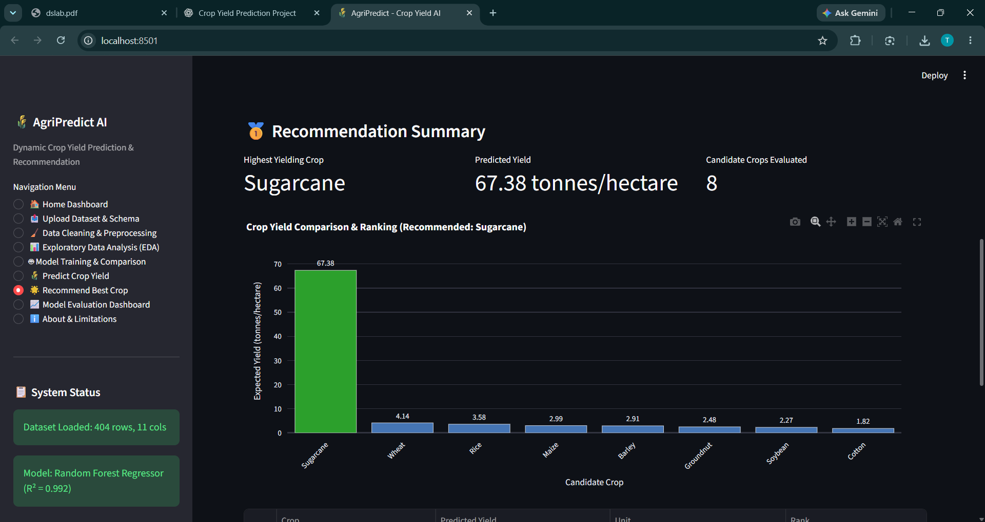
Working Prototype / Output Screens
Home dashboard
Displays agricultural charts and explanatory insights.
Farm input and prediction
Displays agricultural charts and explanatory insights.
Crop analytics
Displays agricultural charts and explanatory insights.
Notes:
Show real screenshots, photos of the hardware or a short demo video link. Caption each one with what the viewer should notice.

Slide 14
Results & Performance Comparison
Chart and table hold illustrative values only. Replace them with your own results.
Notes:
Right-click the chart and choose Edit Data to enter your real numbers. Replace the metrics with the ones that fit your project (accuracy, latency, power, throughput, user rating). State clearly which option performed best.

Slide 15
Analysis & Key Findings
Not measured
No validated performance metric is available for this prototype.
Interpretation: Results are indicative crop-suitability guidance, not a guarantee.
Error analysis: Recommendations may be inaccurate without local soil and weather calibration.
Key drivers: Soil, rainfall, temperature, humidity, season, irrigation, region and fertilizer.
Prototype output example only; no validated model-performance metrics are available.
Notes:
Explain what the numbers mean. Use a confusion matrix, ROC curve, feature-importance chart or output comparison. Be honest about weak results; panels value that.

Slide 16

Testing & Validation
Test ID | Test Description | Expected Result | Actual Result | Status
TC-01 | Upload valid CSV dataset | Dataset uploaded and preview displayed | Dataset uploaded successfully | Pass
TC-02 | Handle missing values | Missing values identified and handled | Missing values checked successfully | Pass
TC-03 | Train ML regression model | Model trains and evaluation metrics are displayed | Model trained successfully | Pass
TC-04 | Predict crop yield | Predicted yield is displayed for valid inputs | Yield prediction generated successfully | Pass
Functional Testing
Validation Method
Performance Testing
[Unit and integration tests performed]
[Cross-validation, hold-out or field trials]
[Speed, load, accuracy or reliability checks]
Notes:
List representative test cases with expected and actual outcomes. Name the validation methods you used. Delete rows you do not need.

Slide 17


Challenges & Limitations
Challenges Faced
Limitations
No validated local dataset → prototype uses transparent rules and documents this limitation.
Regional variation → local district calibration is identified as future work.
Demo yield formula → output is clearly labelled illustrative.
No validated local agricultural dataset.
Suitability scores are heuristic, not trained model predictions.
Yield estimate is illustrative, not an agronomic forecast.
Notes:
Be candid. Pair every challenge with how you solved it, and list limitations that the panel would otherwise spot themselves.

Slide 18

Conclusion
1
A browser-based crop recommendation and yield-estimation prototype using user-entered farm conditions.
Final Outcome
Not measured
2
The interface ranks five candidate crops. No validated accuracy or comparative evaluation was supplied.
Five-crop ranked shortlist
Prototype objectives demonstrated: 4 of 4
3
The prototype demonstrates multi-factor crop comparison and communicates its assumptions and limitations.
Notes:
Revisit each objective and say whether you met it. Quote your headline result with numbers. Do not introduce new material here.

Slide 19



Future Scope & Applications
Improve Performance
Calibrate rules and train/evaluate models on reliable local agricultural datasets.
Applications
Preliminary crop comparison
Agricultural education
Farm planning support
Farmers, students and agricultural educators.
Expand Data / Features
Add district-level soil tests, weather history, crop varieties and local recommendations.
Deploy & Build an Interface
Connect a validated backend prediction API and deploy the interface.
Scale & Secure
Add secure hosting, monitoring and reliable data management.
Notes:
Give concrete next steps, ideally tied to the limitations. Then name two or three real-world uses.

Slide 20
Team Contribution
Registration Number | Team Member | Contribution
2420030467 | K.V.S Jaswant | Project coordination and interface integration
2420030737 | Teja Darupu | Crop suitability and prediction workflow
2420030754 | K. Bharghav | Analytics, testing and documentation
Notes:
Show that work was planned and shared. Every member should be able to explain their own module.

Slide 21

References
Tool / Technology Purpose
Python Main programming language
VS Code Development environment for writing and running code
Streamlit Builds the interactive web application
Pandas Data loading, cleaning and manipulation
NumPy Numerical calculations and data processing
Scikit-learn Machine-learning model training and evaluation
Matplotlib Data visualization and graphs
Plotly Interactive charts and visualizations
Joblib Saving and loading trained ML models
Openpyxl Reading Excel datasets
CSV / Excel Agricultural dataset formats
Project Links
GitHub: Not supplied
Dataset: Not supplied
Demo video: Not supplied
Notes:
Use IEEE style, numbered in order of first citation in the deck. Include datasets, documentation and code repositories.

Slide 22
THANK YOU
Questions & Discussion
[TEAM MEMBERS
2420030467 – K.V.S Jaswant
2420030737 – Teja Darupu
2420030754 – K. Bharghav
Guide: N. Sunanda | Academic Year: 2026–2027
Notes:
Leave this slide up during questions. Make sure every team member can answer questions about their own module.

